Slide 1

AI TOOL USAGE AMONG INDIAN COLLEGE STUDENTS
S .Angeline Praisy
AF05105575
ANP-D4856

Slide 2
PROBLEM SATEMENT
To analyze the variations in AI tool usage among Indian college students and identify why AI tools have lower adoption rates in specific academic streams and geographical regions and evaluate how usage of AI tools impacts academic outcomes .

Slide 3
OBJECTIVES
To analyze the overall patterns of AI tool usage among Indian college students.
To examine the differences in AI usage across various academic streams.
To study the variation in AI adoption among students from different states in India.
To identify the reasons for lower AI tool usage in certain streams and regions.
To evaluate the impact of AI tool usage on the academic outcomes of the students.

Slide 4
KEY INSIGHTS
AI tools such as ChatGPT, Gemini, and Copilot are among the most commonly used tools by students for academic purposes. There are other powerful specific AI tools like Claude and Midjourney which are yet to be popularly used by the students due to lack of branding, utility differences.
Science, Engineering & Arts students show relatively higher usage of AI tools compared to some other academic streams like Agriculture, Pharmacy and Law. This is majorly due to lack of proper integration of AI in academic institutions .
Usage patterns vary across different states. While Jammu and Goa shows high number of usage, while states like Mizoram, Manipur, Tripura and Dadra show less number of AI tool usage. This can be attributed to geographical and political reasons.
Many students report that AI tools help improve learning efficiency but that is not much reflected in the academic performance. Students who are not using AI efficiently are also showing good performance in their academics. Hence, spending more time in AI is not playing a major role in the academic scores of the students.

Slide 5
SOLUTION
Solution for efficient usage of AI tools across different streams
1.Establish Clear AI Usage Policies
2.Train Teachers and Faculty.
3.Update Assessment Methods
Solution for efficient usage of AI tools across different states
1.Strengthen Digital Infrastructures
2.Provide Free National AI Learning Platforms.
3.Subsidized AI Software for Students
4.Regional Language AI Support
Solution for making AI utilised more effeciently to positively impact Academic performance
1. Increase Awareness of AI Tools
2. Provide Training on Effective Usage

Slide 6
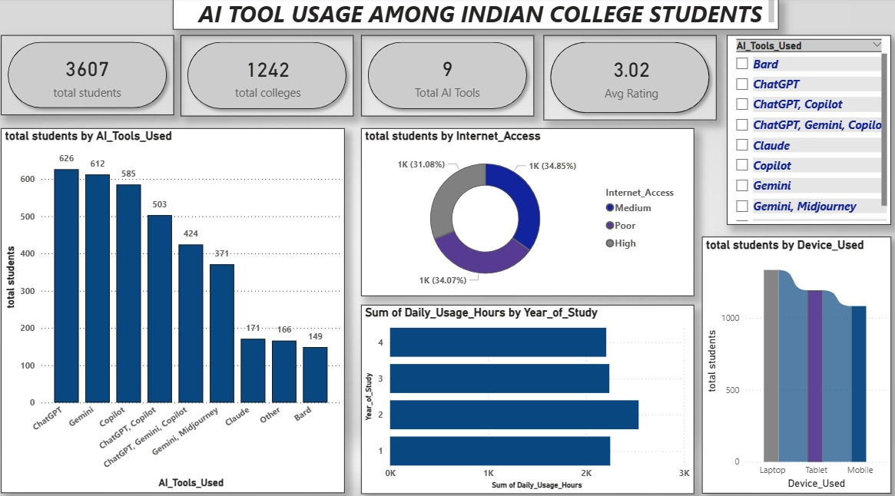
DASHBOARED 1

Slide 7
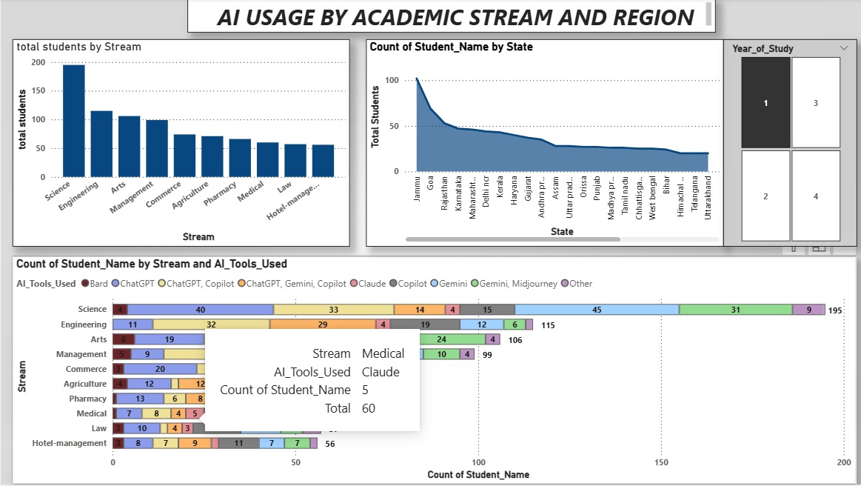
DASHBOARED 2

Slide 8
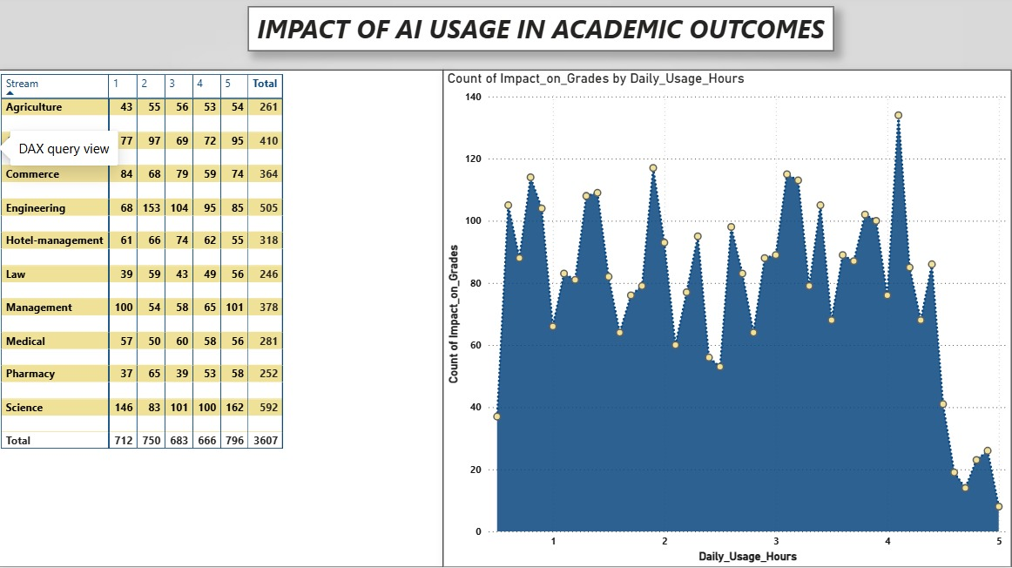
DASHBOARED 3

Slide 9
CONCLUSION
AI tools are becoming an important support system for students in academic learning..
However, AI adoption is not uniform across streams and regions. And the usage of AI is not being effectively reflected in the academic outcomes of the students.
Hence, there is a comprehensive policy needed by educational institutions to implement proper usage of AI tools. And the Government should help the institutions in achieving the goal by providing National free Teachers Training programs. And students should also get access to some AI software to use it for their education.
However, the above need proper regulation and monitoring. So, there is a high need for a regulatory framework and policy.
Students should efficiently use AI but it should not compromise students skills and potential in any way.

Slide 10

THANK YOU

